Slide 1

Form to Flow: a cloud-based workflow automation system for teaching introductory CFD courses
Mark Benjamin (markben@stanford.edu) and Gianluca Iaccarino (jops@ )
Department of Mechanical Engineering, Stanford University
APS DFD 2024
November 25, 2024

Slide 2
Motivation: a course in computational engineering
The course
From the course description of ME 123 at Stanford University …
“… This course introduces Computational Engineering, emphasizing the analysis of flow, structural and thermal characteristics for optimizing engineering systems such as wind turbines and biomedical devices. Designed for students with limited computational experience, it combines lectures and hands-on tutorials to teach geometry modeling, mesh generation, solution strategies, and post-processing. Key concepts include Verification and Validation for simulation accuracy and advanced topics like turbulence modeling and automation. The course culminates in an industry-inspired project. … ”

Slide 3
Motivation: a course in computational engineering
The course
From the course description of ME 123 at Stanford University …
“… This course introduces Computational Engineering, emphasizing the analysis of flow, structural and thermal characteristics for optimizing engineering systems such as wind turbines and biomedical devices. Designed for students with limited computational experience, it combines lectures and hands-on tutorials to teach geometry modeling, mesh generation, solution strategies, and post-processing. Key concepts include Verification and Validation for simulation accuracy and advanced topics like turbulence modeling and automation. The course culminates in an industry-inspired project. … ”

Slide 4
Motivation: a course in computational engineering
The course
From the course description of ME 123 at Stanford University …
“… This course introduces Computational Engineering, emphasizing the analysis of flow, structural and thermal characteristics for optimizing engineering systems such as wind turbines and biomedical devices. Designed for students with limited computational experience, it combines lectures and hands-on tutorials to teach geometry modeling, mesh generation, solution strategies, and post-processing. Key concepts include Verification and Validation for simulation accuracy and advanced topics like turbulence modeling and automation. The course culminates in an industry-inspired project. … ”

Slide 5
Motivation: a course in computational engineering
The students
Prerequisites: Introductory solid, thermal and fluid mechanics courses.
Upper-level undergraduates in mechanical or biomedical engineering.
Have basic familiarity with CAD tools.
Do not have much HPC or Unix system experience.

Slide 6
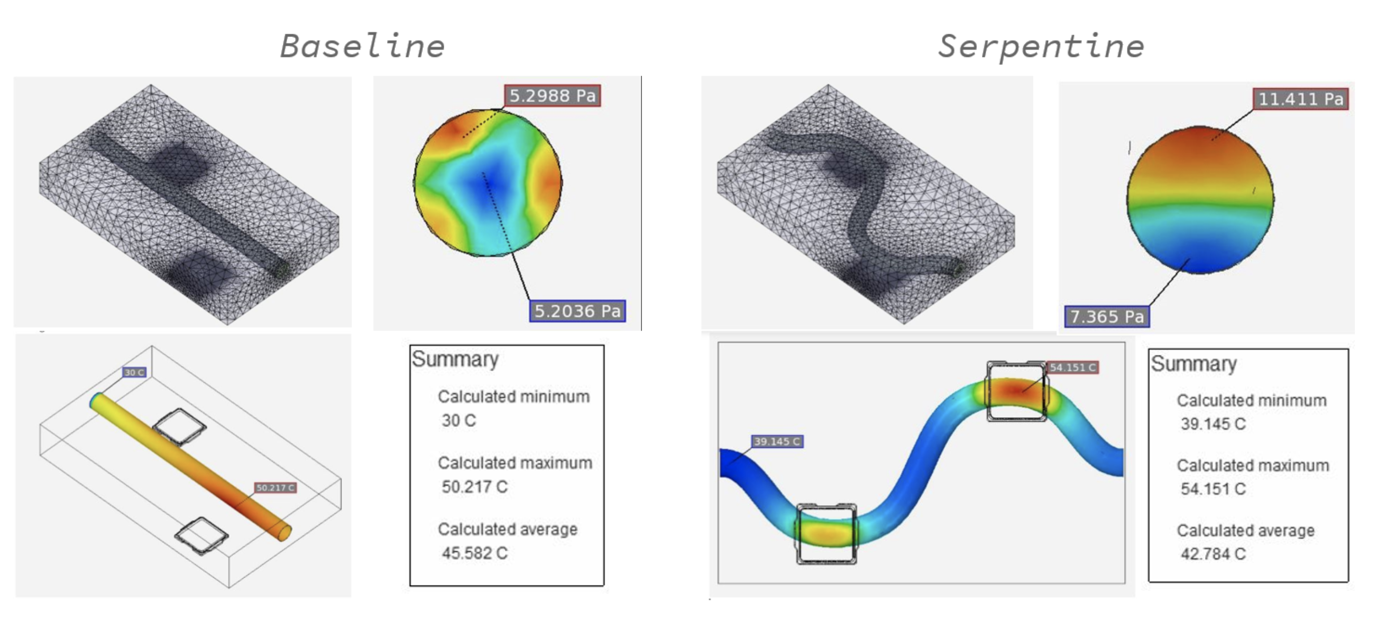
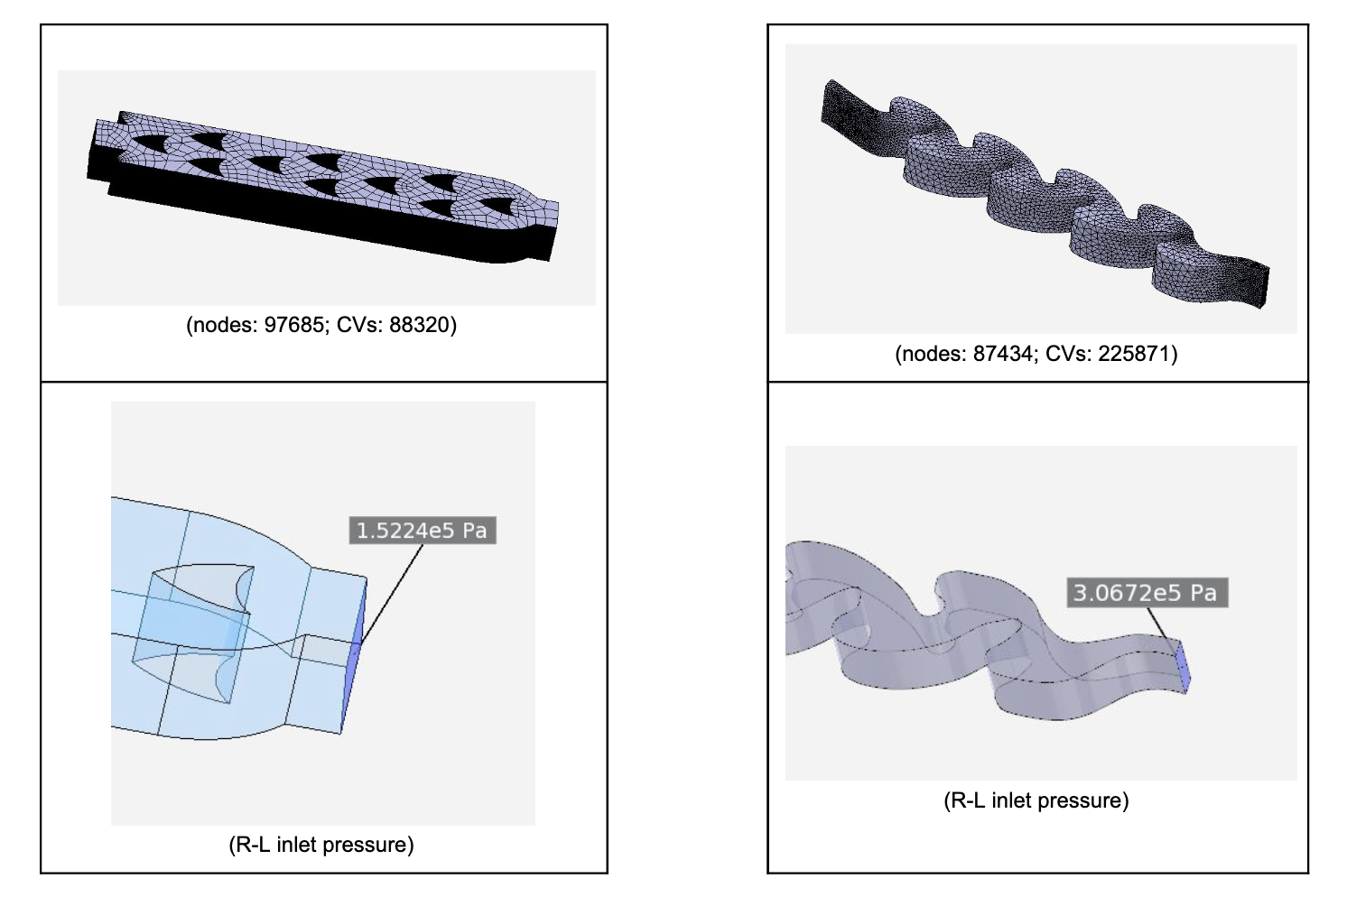
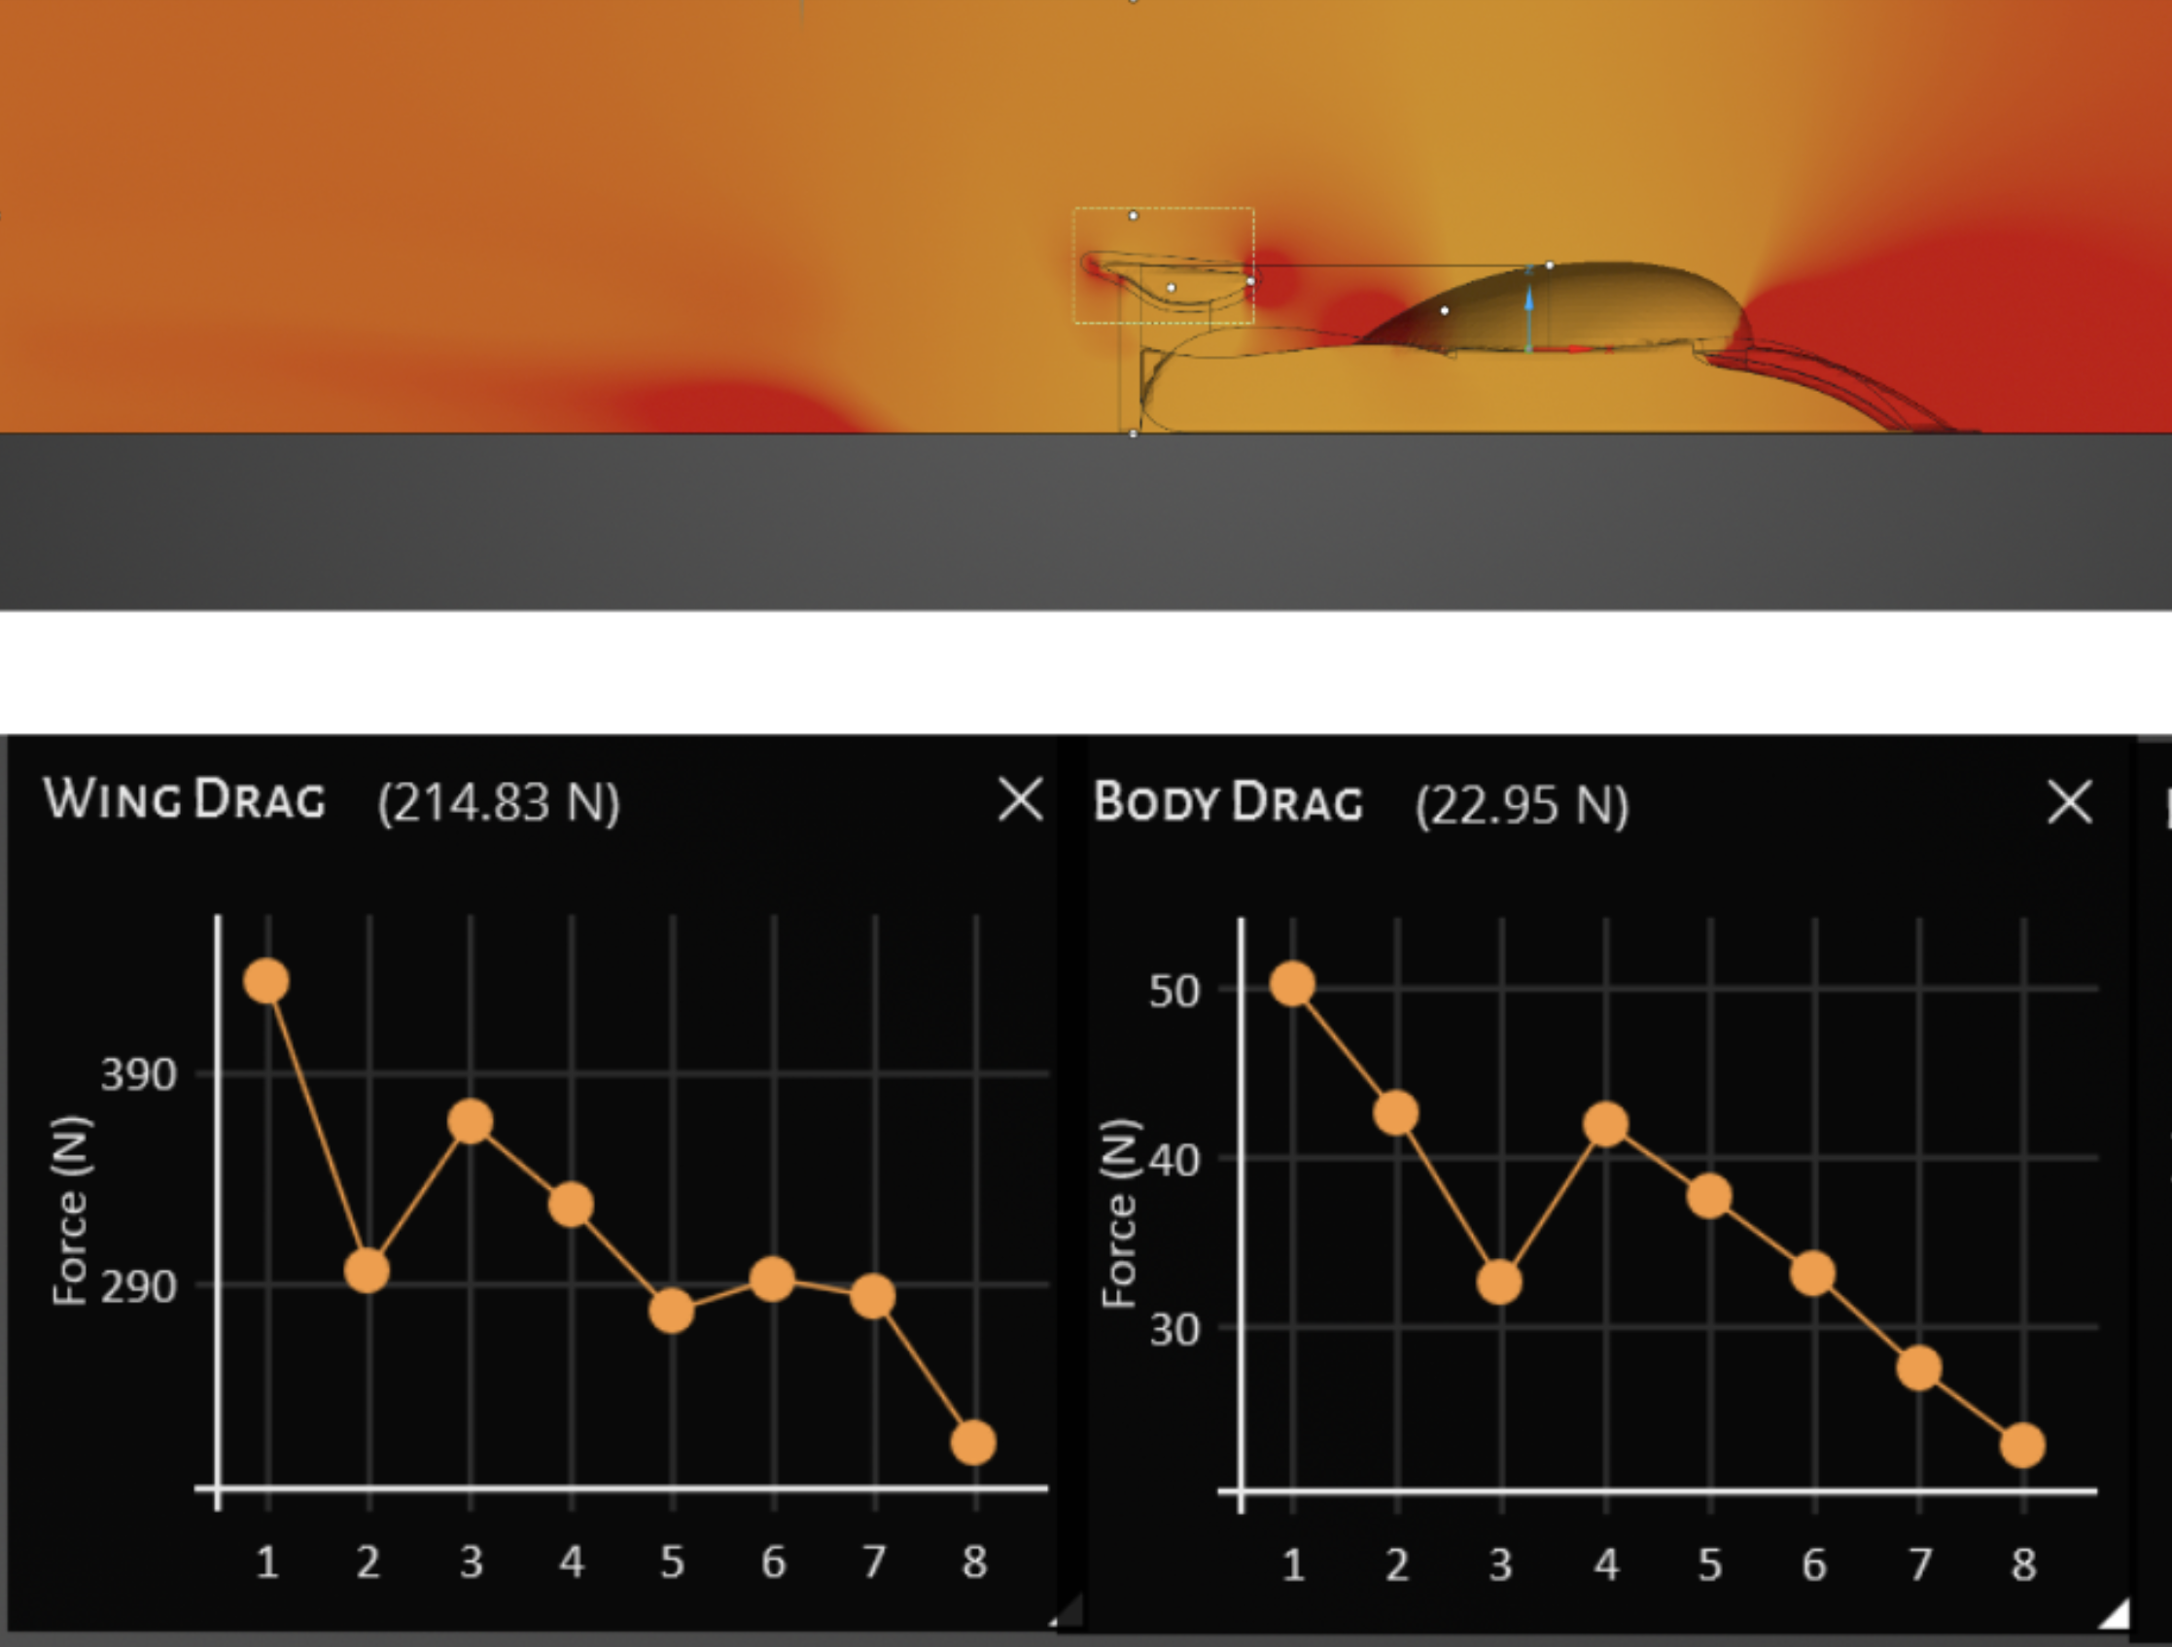


Motivation: a course in computational engineering
The project
A multi-physics design application of engineering interest, using physics simulations.
Designing a CPU cooling solution
Designing a fluid diode
Designing a racecar wing
These projects require giving students access to powerful, general-purpose simulation tools!

Slide 7



Access to simulation software
Option A: provide computers to students with simulation tools pre-installed.
Pros: standardized hardware
Cons: cost
Option B: provide instructions/software licenses for students to use their own computers.
Pros: logistical ease
Cons: software incompatibility, troubleshooting
Solution: use a cloud-based simulation tool?

Slide 8
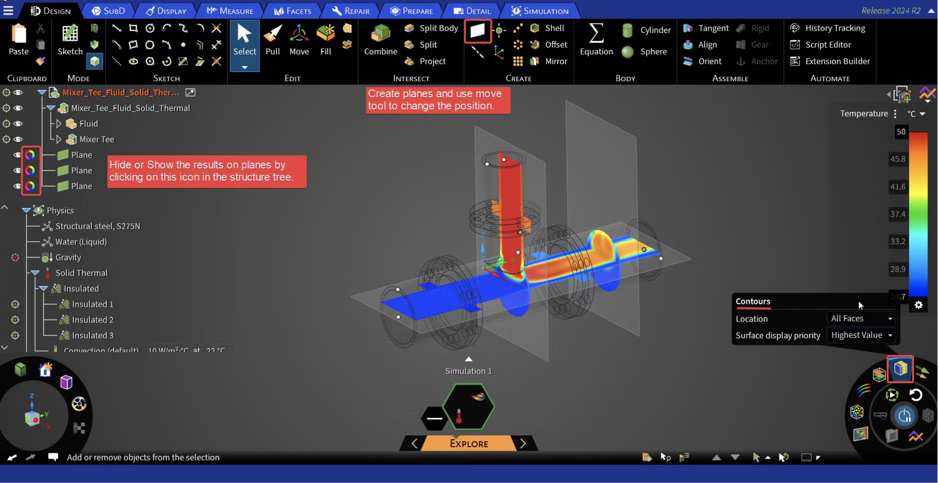
Challenges with existing software
A lot of time is invested in navigating the complex UI, far less in post-processing and interpreting results.
The class objective is to give students understanding of virtual prototyping, not familiarity with a specific simulation software.

Slide 9
What we need
A workflow for handling software access to students that
Abstracts away unnecessary features of the simulation tool.
Standardizes hardware across all students.
Some other preferred features:
Allows students to use their own computers.
Is agnostic to the specific tool used for the simulations.
Does not present additional cost burden for course organization.

Slide 10



The ideal student interaction with the solvers
The student loads a geometry of interest for analysis.
The student makes choices about the domain, boundary conditions, mesh details and simulation settings as needed.
The student receives the results from the calculation, along with error messages, if any.
The student processes the results and develops intuition for design exploration.

Slide 11
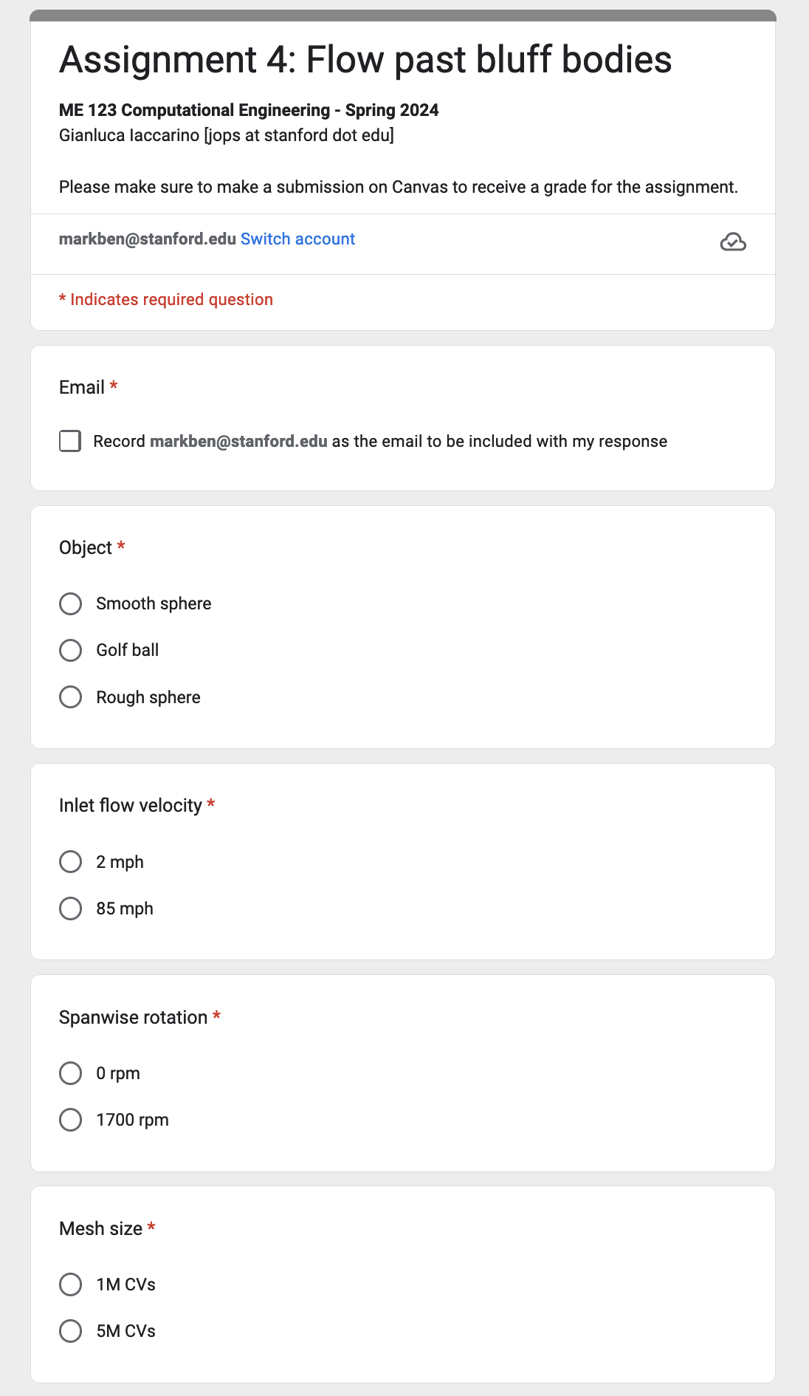
Assignment submission using Google Forms
Each submission associated with a student.
Only required settings are exposed.
File upload directly possible.
Google Forms is cross-platform (even mobile!)
How do we manage all these submissions from multiple students?
How do the students receive the results from their simulations?

Slide 12
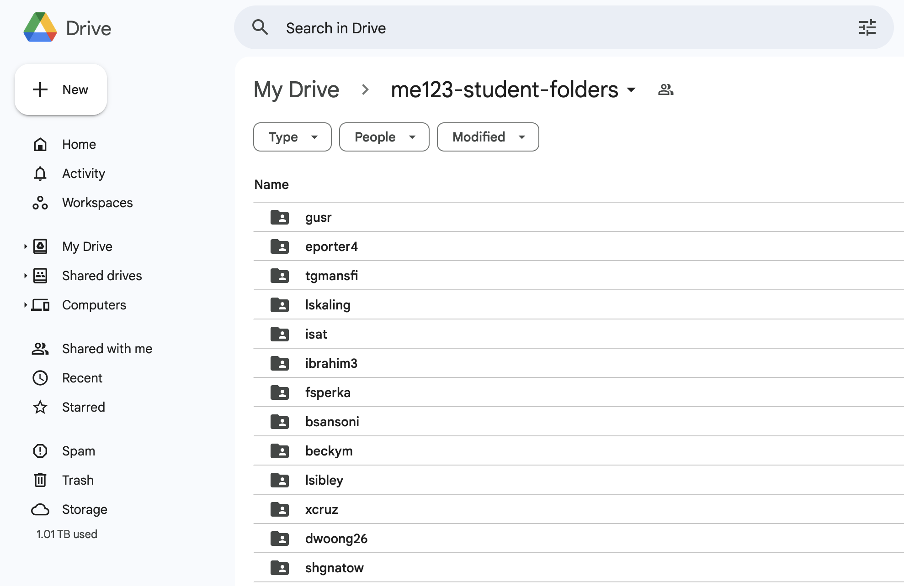
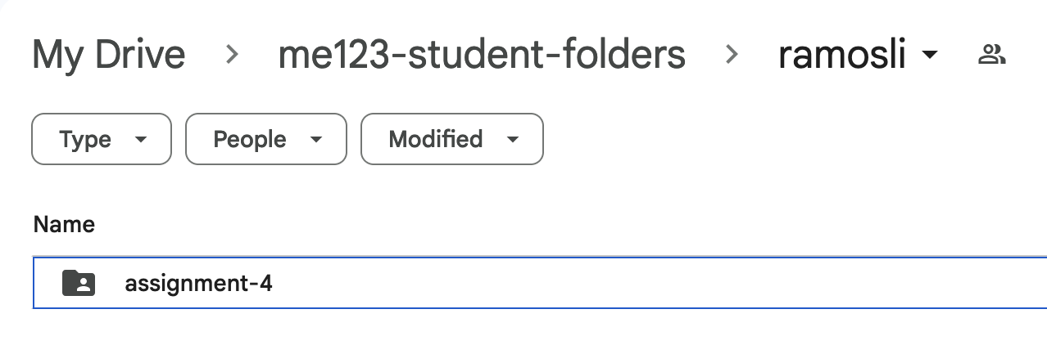
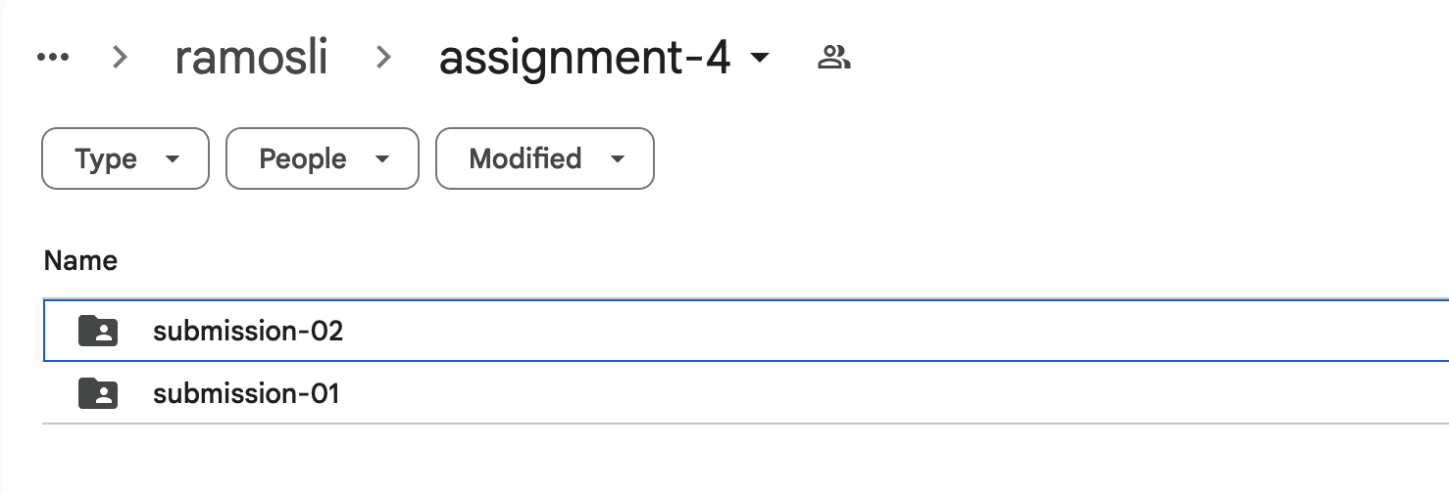
Assignment management using Google Drive
Each student gets their own submission folder …
The results from each submission (simulation) for a given assignment are available in the students’ submission folder, viewable only to themselves.
… which contains folders for each assignment …
… with individual sub-folders for each simulation.

Slide 13
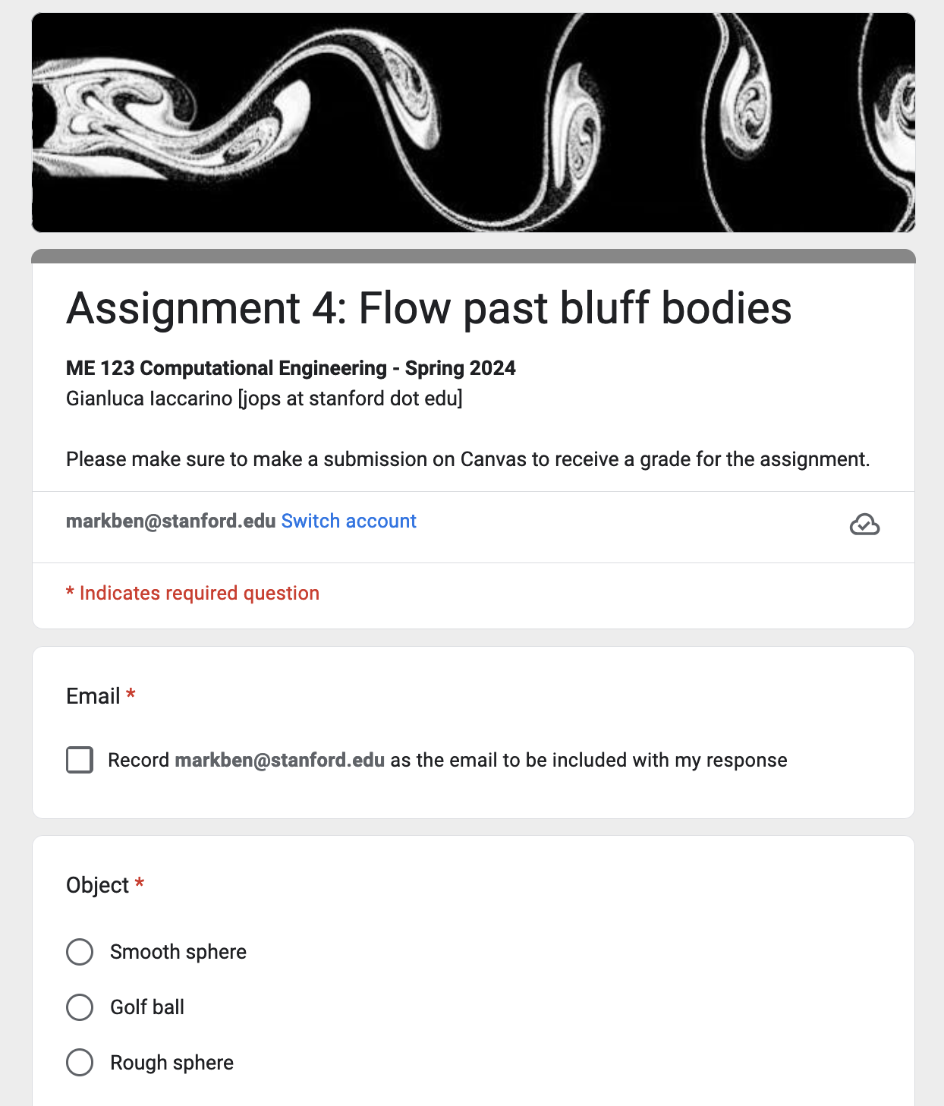
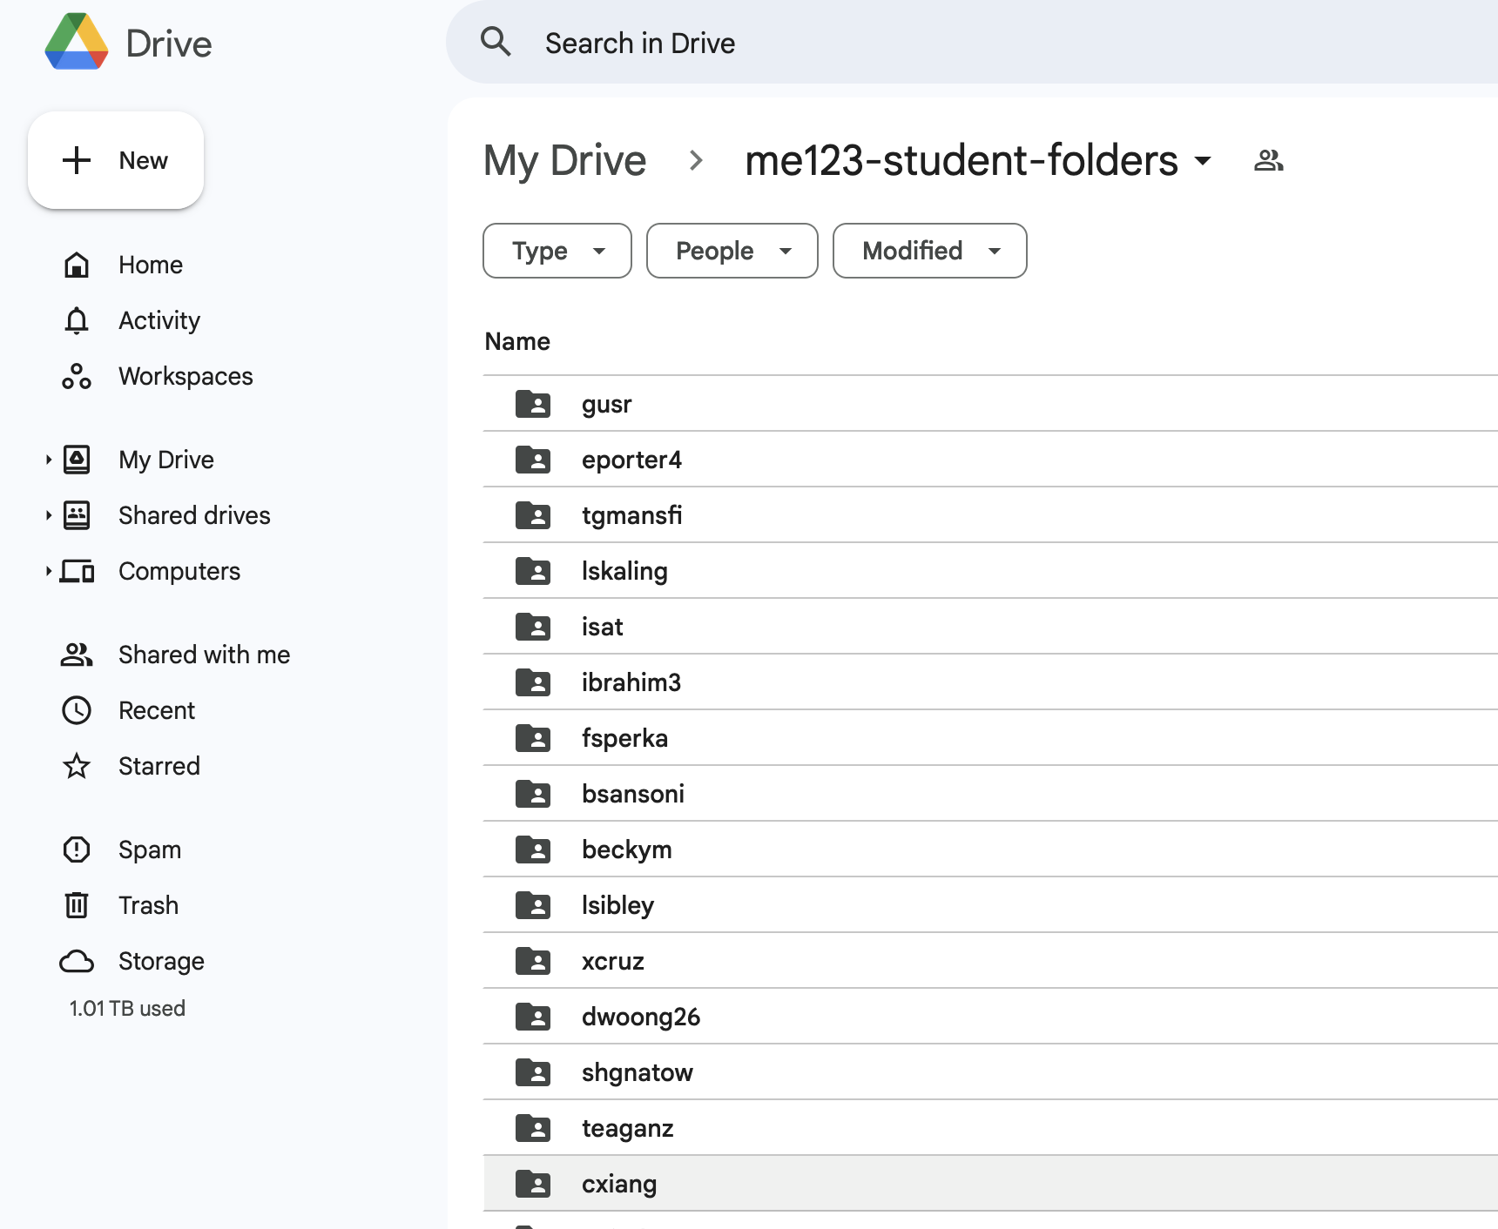
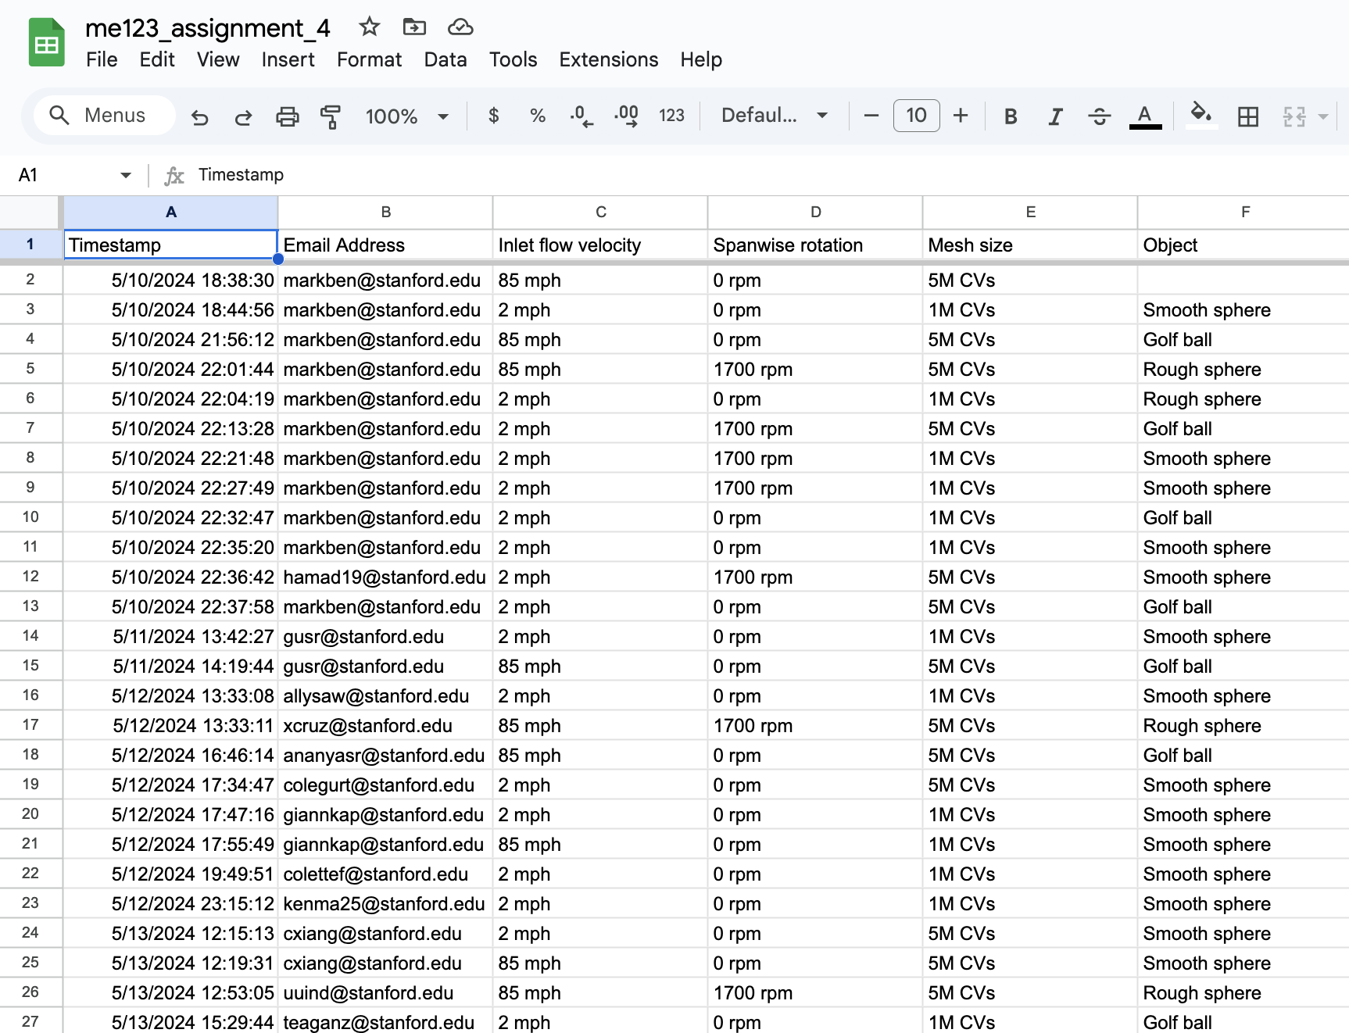
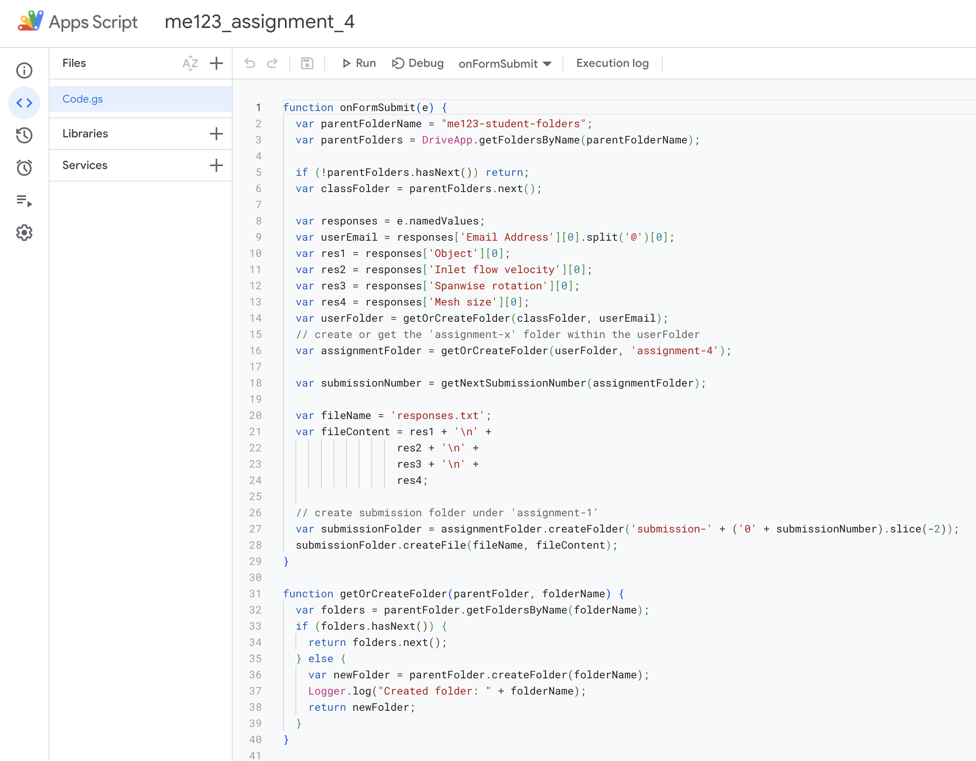
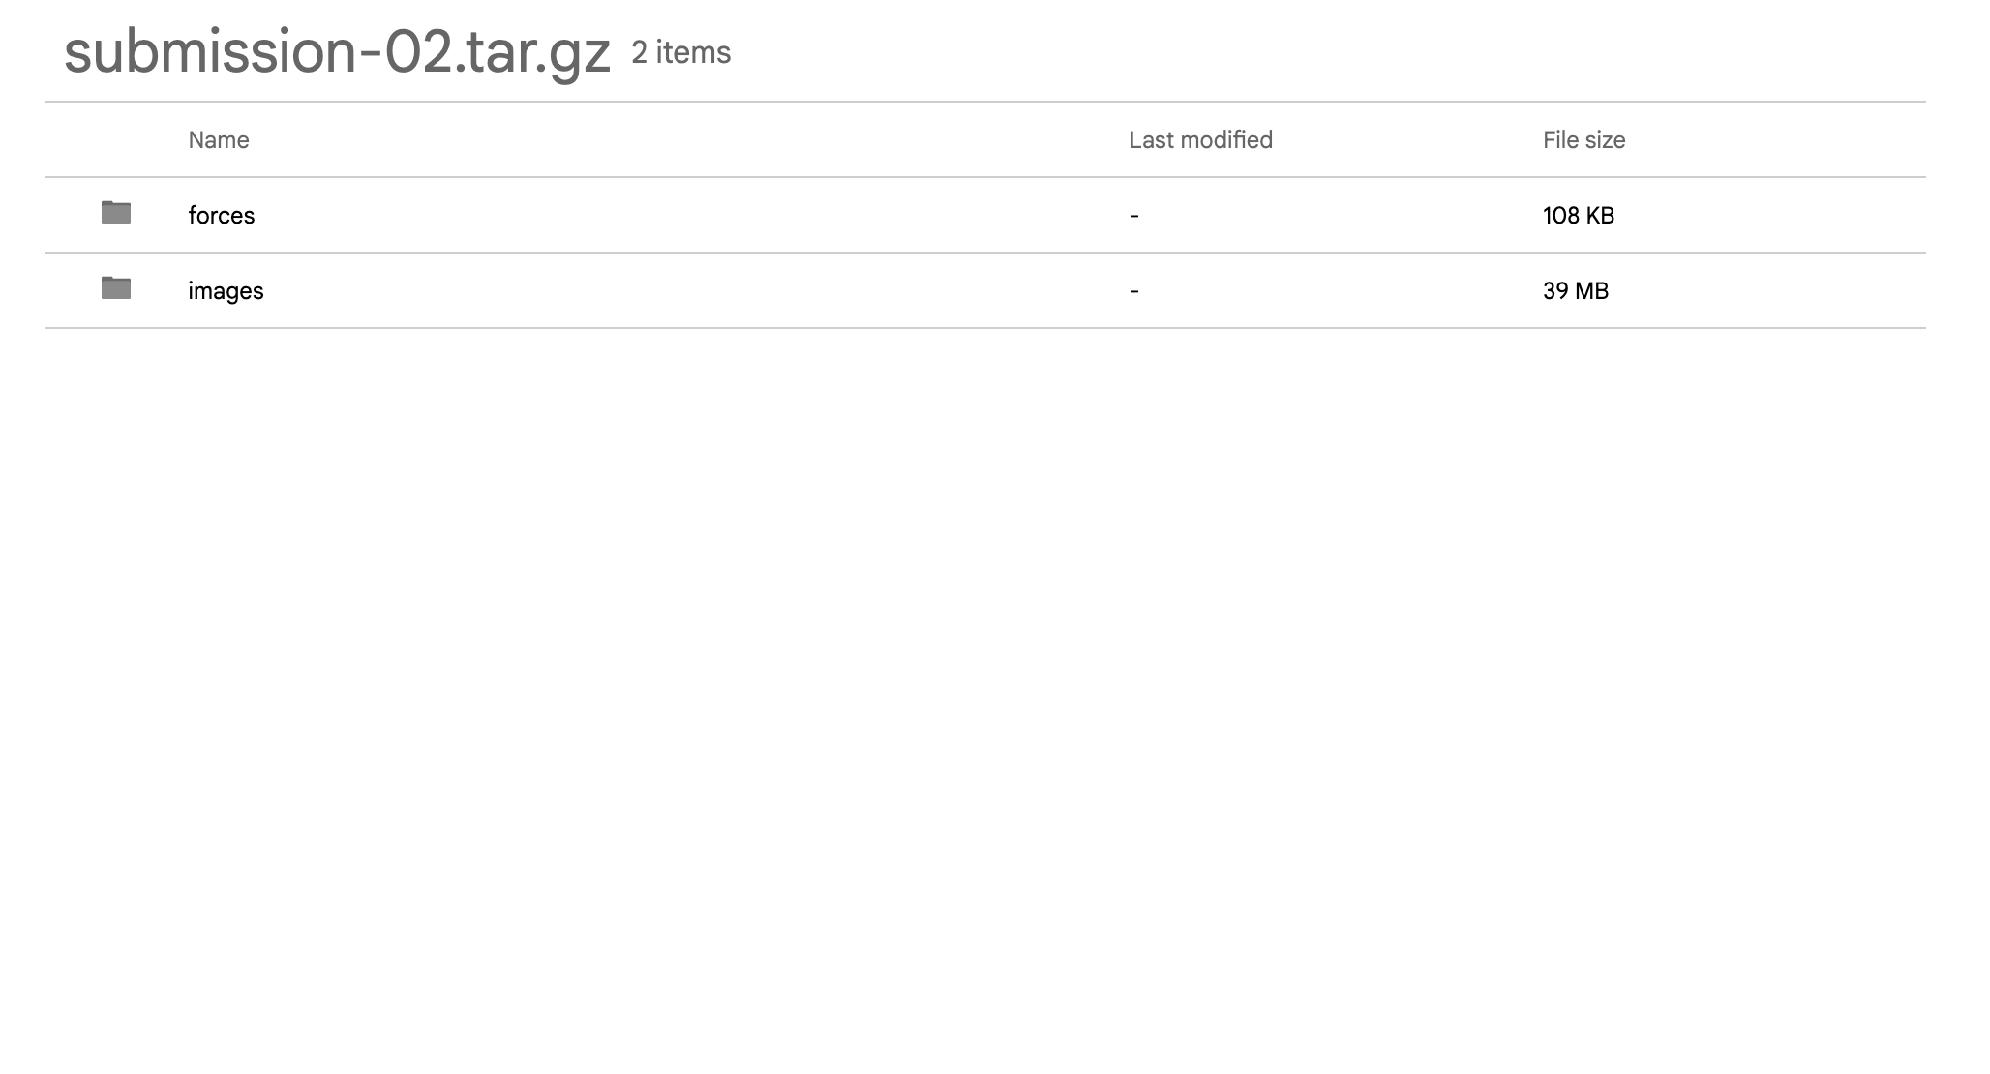






Form to Flow
Bash scripts on the cluster parse the submission to generate input files, submit simulation jobs to a queue, and copy back results and error messages
HPC cluster
Students only interact with Google Forms and Google Drive!

Slide 14
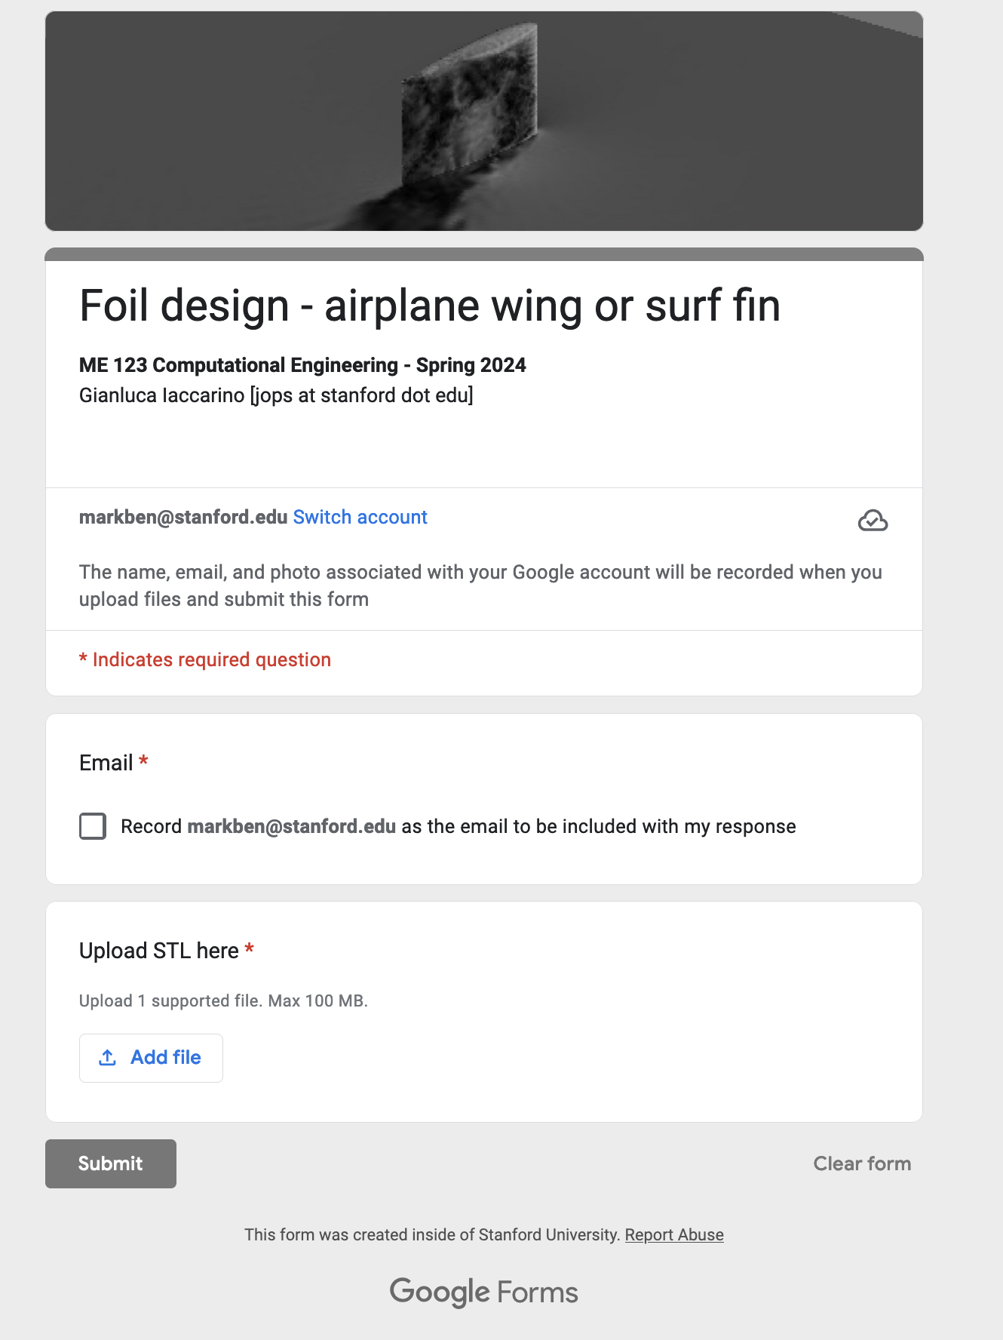
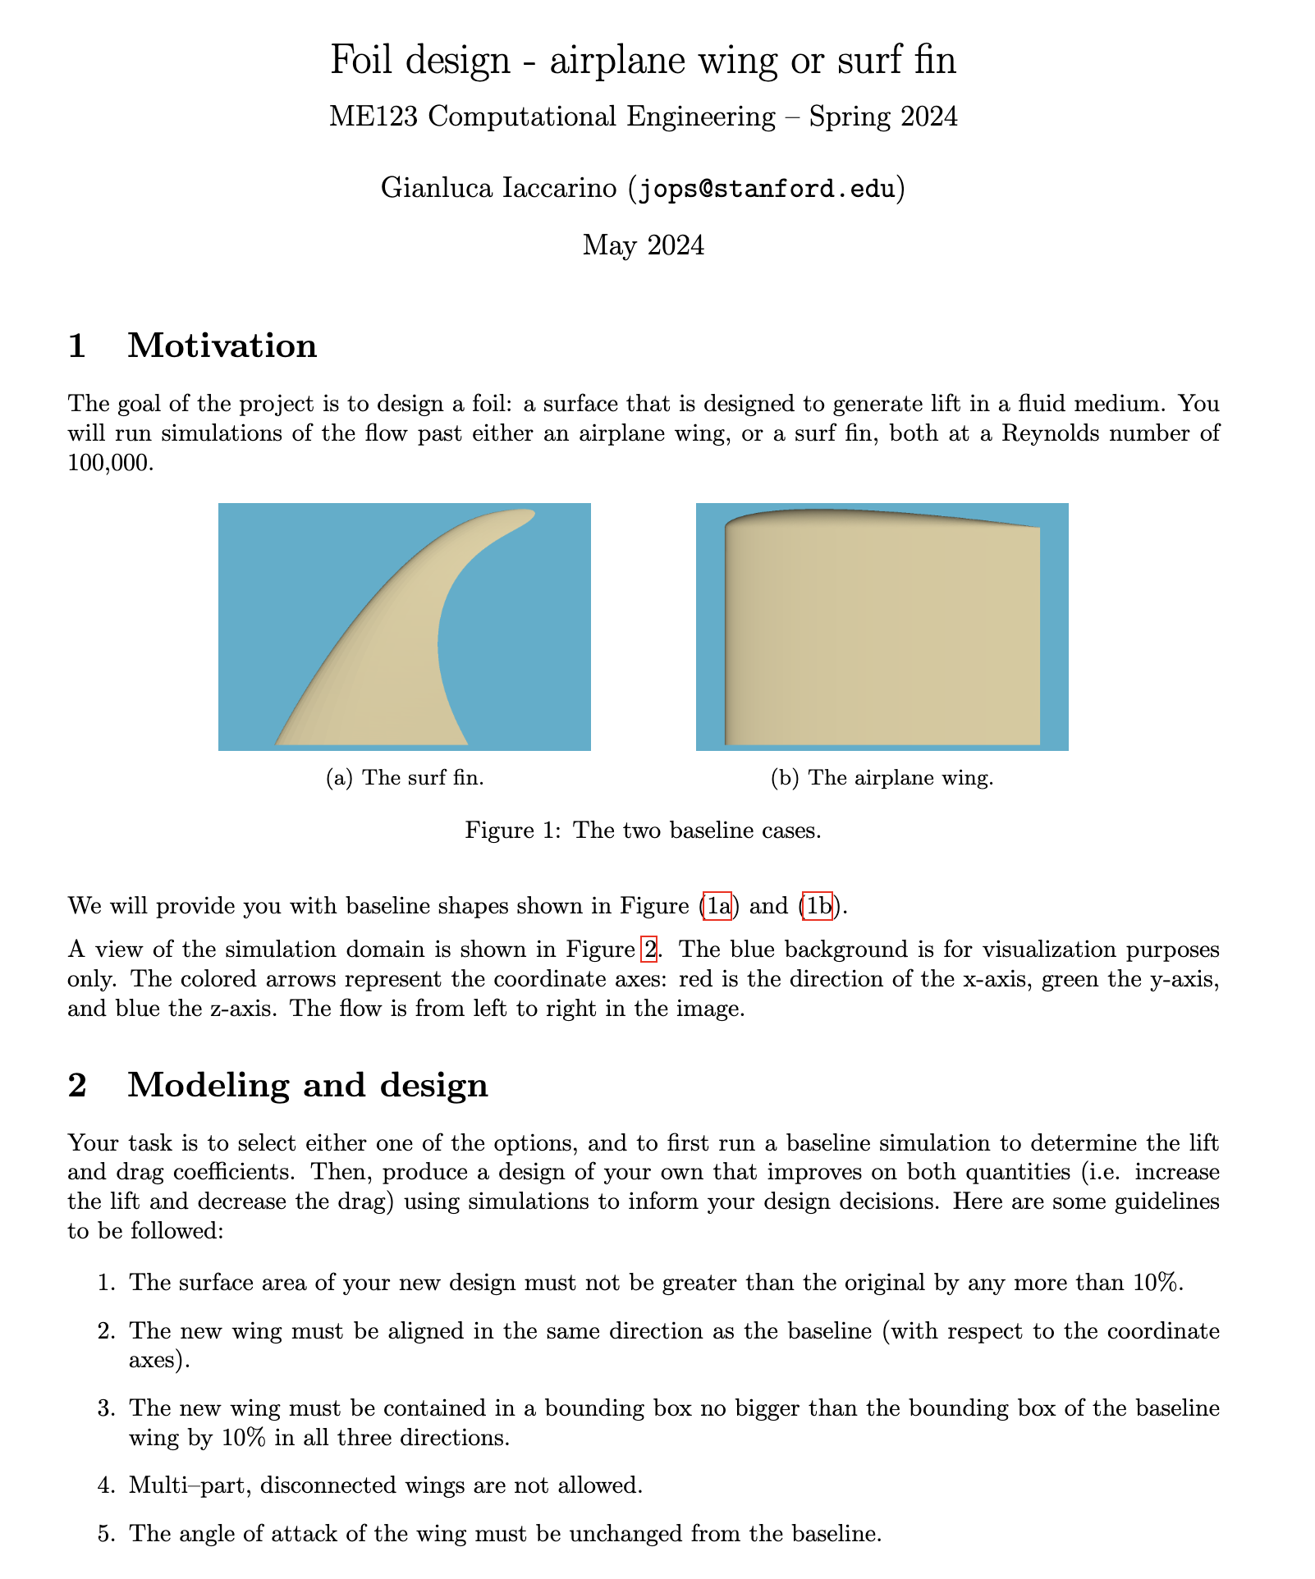
Front-end experience example
Form to Flow trialed in situ at Stanford University in Spring 2024.
Simulations run using the Fidelity CharLES solvers.
Used the Yellowstone HPC system.
One of the final projects:

Slide 15
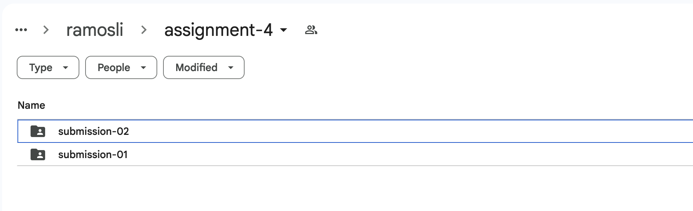
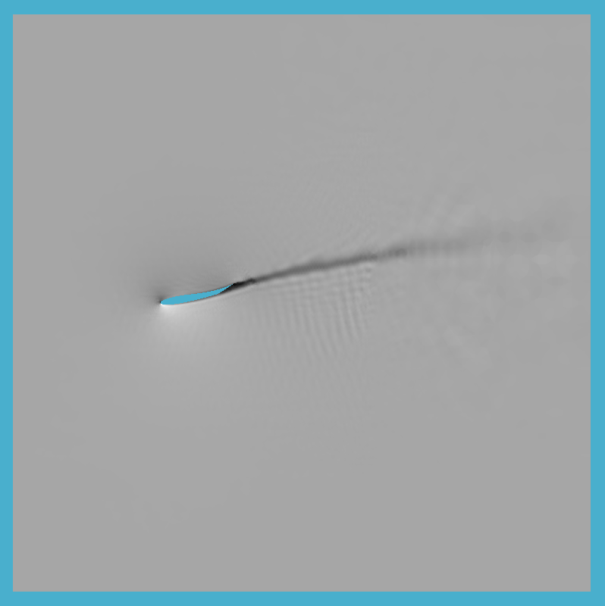
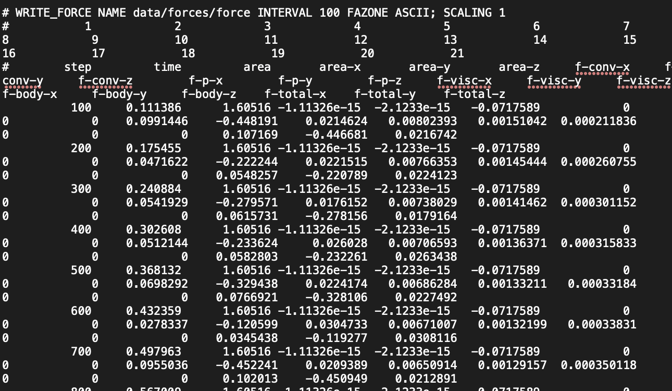
Front-end experience example from Spring 2024
After submission, students receive the results in their submission folder on Google Drive

Slide 16

Form to Flow
A workflow for handling software access to students that
Abstracts away unnecessary features of the simulation tool.
Standardizes hardware across all students.
Some other preferred features:
Allows students to use their own computers.
Is agnostic to the specific tool used for the simulations.
Does not present additional cost burden for course organization.

Slide 17
Benefits
Enables use of HPC systems and performant solvers for all students.
Easy monitoring of student progress and troubleshooting.
Only exposes the parts of the tools that are required for the students’ understanding of class materials
Portable and modular; can use any solver or software.
Only uses free tools with robust support.
Cons:
Requires initial time investment by teaching team.
Questions?

